Slide 1
IO Lab
Spring 2016
Module 2 - Lec 2 - CSS
Jan 29, 2016

Slide 2




Course Map
Getting Started
Front End
Back End
Advanced Topics
Introduction
Fundamentals
Git
Command Line
HTML
CSS
Responsive Design
JavaScript & jQuery
Web Frameworks
Architecture
Database Design
APIs
Visualization
Security
Deployment

Slide 3
Course Map
Getting Started
Front End
Back End
Advanced Topics
Fundamentals
Git
Command Line
HTML
CSS
Responsive Design
JavaScript & jQuery
Web Frameworks
Architecture
Database Design
APIs
Visualization
Security
Deployment

Slide 4
Front End Module
HTML
CSS & Responsive Design
JavaScript & jQuery

Slide 5
Front End Module - CSS
HTML
CSS & Responsive Design
JavaScript & jQuery

Slide 6
Goals Today (Same as HTML)
Foundational understanding of CSS
Brush up & fill in the gaps
Display & Layouts
The Box Model
Positioning

Slide 7
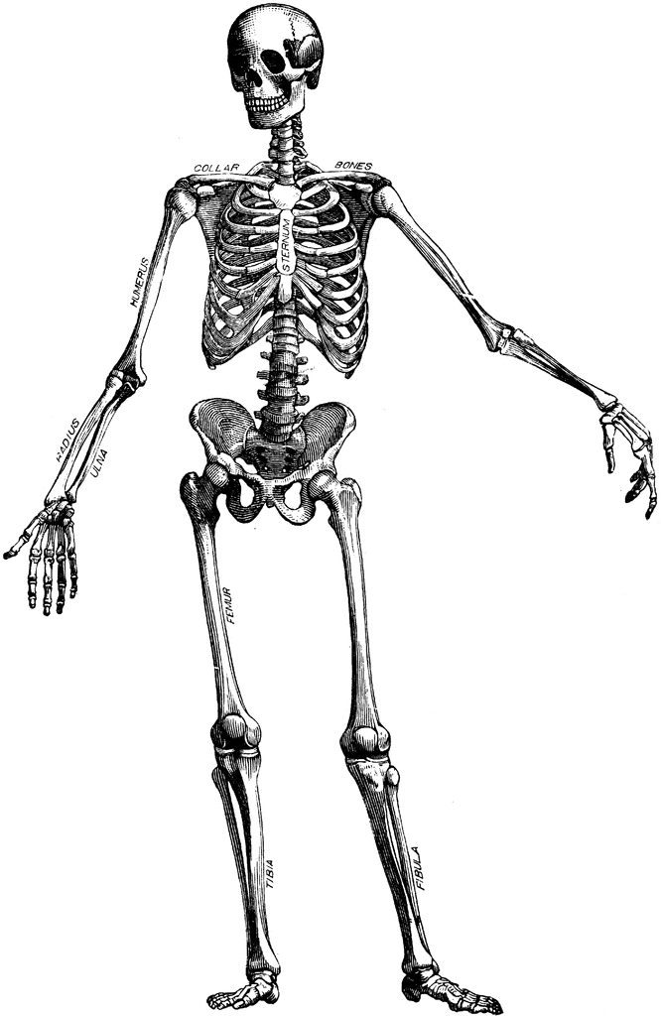
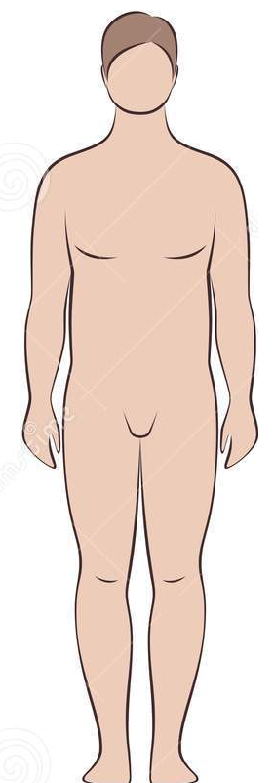
CSS - Appearance
CSS is the presentation layer
If HTML is like the skeleton, then CSS is like the skin
HTML
CSS

Slide 8
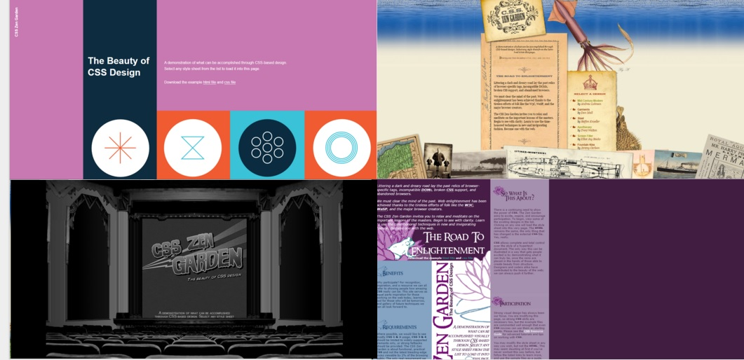
Architectural Thinking
Check Out CSS Zen Garden
If architected correctly, the same underlying content can be presented in any number of ways using CSS

Slide 9
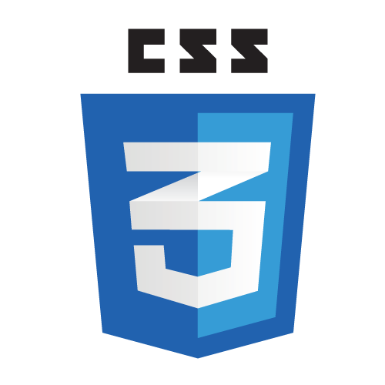
CSS
Cascading
Style
Sheets

Slide 10
CSS - A Set of Appearance Rules
Layout & Positioning
Sizing & Spacing
Colors & Fonts
Animation

Slide 11
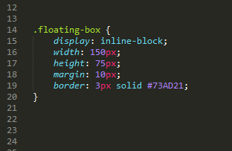
CSS - Getting a Handle with Selectors
Selectors used to target individual or multiple elements for styling
3 Common selectors
Class (denoted by a period before the class name)
ID (denoted by a hash mark before the ID name)
Element Type (no preceding punctuation)
There are also more complex selectors
More on this later
This selector is selecting all elements with the ‘floating-box’ class
A fun way to practice your CSS selection skills

Slide 12
CSS - Syntax
declaration block
.class-name {width: 100px}
selector
property
value

Slide 13
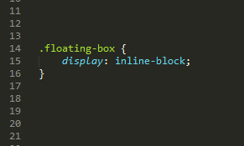
CSS - Properties & Values
Once you’ve targeted one or more elements with a selector, you can style the element(s) by setting the values of their properties
Here, we’re selecting the ‘display’ property to style
Here, we’re setting the ‘display’ property’s value to ‘inline-block’

Slide 14
CSS - The Cascade
Cascade of files
Later files loaded in HTML will take precedence over earlier files
Cascade of declarations
Later selectors in CSS file will take precedence over earlier selectors
Unless a more specific selector is used - more on this in a moment
Cascade of properties within declaration
Later declared property-values take precedence over earlier declared property-values

Slide 15
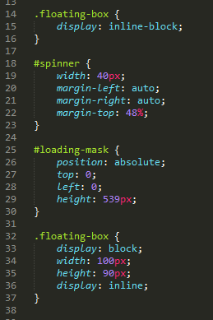
CSS - Cascade of Declaration Example
The properties declared in the second .floating-box declaration will override any corresponding properties declared in the first .floating-box declaration

Slide 16
CSS - Cascade of Properties Example
The second display property declaration will override the first display property declaration

Slide 17
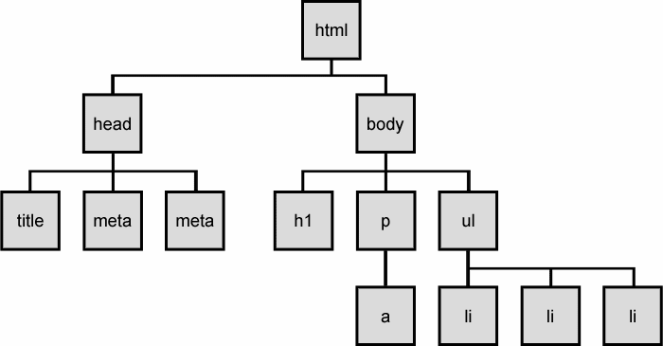
CSS - Inheritance
Separate from the Cascade
Similar to genetics
Parent passes on traits to children
In CSS, parent elements usually pass on properties to child elements
Not all properties, such as background-image are inherited
In this case, if we set the font-size of the ul element to 1.5 em, the font size of the li children (and their children) would also be 1.5 em
More on inheritance here List of CSS inheritance values

Slide 18
CSS - Specificity
More-specific selectors will override cascade precedence
In other words, no matter the order in the cascade:
element type < class < ID
less specific
more specific

Slide 19
CSS - The Display Property
Important because it determines how elements are rendered
Four common values:
Block
Inline
Inline-Block
None (prevents element & children from rendering)

Slide 20
CSS - Block Elements
Take up width of parent container by default
Start on new line
Can wrap around other block or inline elements
div, h1-h6, p, & form are block by default
<parent>
Block Elem. 1
Block Elem. 2

Slide 21
CSS - Inline Elements
Do not accept width, height, or vertical margins
Width & height based on content
Positioned side-by-side
Except for anchor elements, should not wrap around block elements
span, a, & img are inline by default
<parent>
Inline Elem. 1
Inline Elem. 2
Inline Elem. 3

Slide 22
CSS - Inline-Block Elements
Can have a specified width & height, like block elements
Can be on same line as each other, like inline elements
Great for creating grids
<parent>
Inline-Block Elem. 1
Inline-Block Elem. 2

Slide 23
CSS - The Box Model
Every html element is treated as a rectangular box
Each box is made up of four parts, which can be styled
Content (Width & Height)
Padding
Border
Margin
margin
border
padding
content

Slide 24

CSS - 3 Different Box Types
content-box
default box type
padding-box
border-box
generally easiest to work with

Slide 25
CSS - Content Box
element width set to 50px
All four parts of the box added together to get the element’s actual total width & height
margin
border
padding
content
10
10
10
10
10
10
50
110 total pixels

Slide 26
CSS - Padding Box
element width set to 50px
The padding is included in the element’s width value
As the padding increases in size, the content decreases in size
Border and margin are added after to get the element’s actual total width & height
margin
border
padding
content
10
10
10
10
10
30
10
90 total pixels

Slide 27
CSS - Border Box
element width set to 50px
The padding and border are included in the element’s width value
As the padding or border increases in size, the content decreases in size
Margin is added after to get the element’s actual total width & height
margin
border
padding
content
10
10
10
10
10
10
10
70 total pixels

Slide 28
CSS - Absolute vs Relative Values
Pixels and points are absolute
Precise but not scalable
1 pixel is 1 dot on the screen
1 point is 1/72 inch (traditionally used in print media)
Percentages & Ems are relative
Percentage - dependent on parent container/element
Em - dependent on font size
Scalable but not as precise
Good for responsive design (more on that in the next lecture)
More on percentages & ems More on pixels & points

Slide 29
CSS - Positioning & Layouts
Most web pages are arranged with elements positioned in a grid layout
Layouts are great because they can be reused
One option is to use Float
Another option is to use Inline-Block
Floats are generally better for positioning individual or groups of elements on the page, while inline-block is generally better for creating a grid layout
But there is no perfect answer!
A good explanation of float vs in-line block A great resource to learn more about layouts

Slide 30
CSS - Float
Originally designed with traditional print-like layouts in mind
Not designed for creating grid layouts
Floating an element removes it from the normal flow of the HTML
Text wraps around the floated element
However, floats cause display issues requiring ‘creative’ workarounds
Using the :after pseudo-element is least messy clearfix method
Clearfix methods

Slide 31
CSS - Inline-Block
All the benefits of being able to use margins, padding, width, height, and vertical-align
No weird collapsing or clearing issues, but still not perfect
Horizontal spacing issue between elements
How to fix the horizontal spacing issues with inline-block

Slide 32
CSS - Layout Exercise - You Try It!
We’re going to create a layout using float and inline-block
Pull files from Git - they’re in the CSS folder
Follow along in class

Slide 33
CSS - The Position Property
Use the Position property to help layout and position elements
Default Position value is Static, but can also be Inherit, Fixed, Relative, or Absolute
Static, Inherit, and Fixed are pretty straightforward
Static - element is in normal flow of document, will match HTML layout
Inherit - element inherits positioning from parent element
Fixed - element is positioned in the exact same spot in the window, regardless of other content

Slide 34
CSS - Relative vs. Absolute Position
Relative & Absolute used to position elements with precision
Relative - element is positioned with respect to itself
Absolute - element is positioned with respect to its closest parent with Relative or Absolute positioning

Slide 35
CSS - Static Position Example
<parent element>
item 1
Imagine we have 4 element items stacked on top of each other
item 2
item 3
item 4

Slide 36
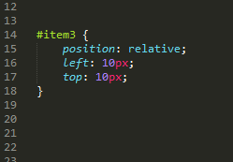
CSS - Relative Position Example
If we set item 3’s position to ‘relative’ and move it 10px from the left and 10px from the top...
<parent element>
item 1
item 2
item 3
item 4
Item 3 repositioned with respect to original, ‘static’ position of itself

Slide 37
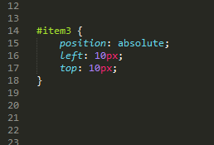
CSS - Absolute Position Example
Now, if we set item 3’s position to ‘absolute’...
<parent element>
item 3
item 1
item 2
item 4
Item 3 repositioned with respect to parent element

Slide 38
CSS - Static vs Relative vs Absolute
Static
Relative
Absolute
<parent container>
<parent container>
<parent container>
item 3
item 1
item 1
item 1
item 2
item 2
item 2
item 3
item 3
item 4
item 4
item 4

Slide 39
CSS - When to Use Different Position Values
Each Position value has its advantages
Fixed - good for non-moving items, like menu bars
Relative - good for smaller adjustments to an element
Absolute - good for when you want an element to always be in the same position relative to its parent
A comprehensive guide to alignment and centering

Slide 40
CSS - Complex Selection
Combine different selectors to target a specific element or group of elements
Spaces between selectors indicate descendant selection
Ex: .container p {width: 60%} selects all paragraphs within elements with the ‘container’ class and sets their width to 60%
Selectors without spaces indicate a combination
Ex: p.sale-item {color: red} selects all p elements that have the ‘sale-item’ class and sets their text color to red

Slide 41
CSS - Other Common Properties
Color (foreground/text)
Background
Background-Image
Font-Size
Font-Weight
Border-Radius
For all of the things, check out HTML Dog’s CSS Properties Reference

Slide 42
CSS - More Best Practices
Reset
Browsers have different styling defaults
Need to reset/recalibrate styles so we know what to expect
http://meyerweb.com/eric/tools/css/reset/ is a good one
Reuse
This is more system-level thinking
If certain styles are being repeated, consolidate into a new class if possible
More on writing good selectors

Slide 43

CSS - In-Class Workshop
Style your HTML code from Wednesday’s class
Create a new CSS file and link to it within your HTML file (see image below on how to do this)
Try to mimic the layout of the actual TechCrunch article; use a grid system
Try to mimic the typography, font colors, and font sizes
Try to mimic the rest of the site’s color scheme
Bonus: Try to emulate the grey tag list on the left-hand side near the top of the page; use hovers
Add this line of code to the ‘head’ section of your HTML file. The href attribute value should match the name of your CSS file.

Slide 44
Assignment 2
Redesign a page from your favorite site
Find in the Homework folder under the Files section of bCourses
Submit via Git (instructions in HW)

